Slide 1
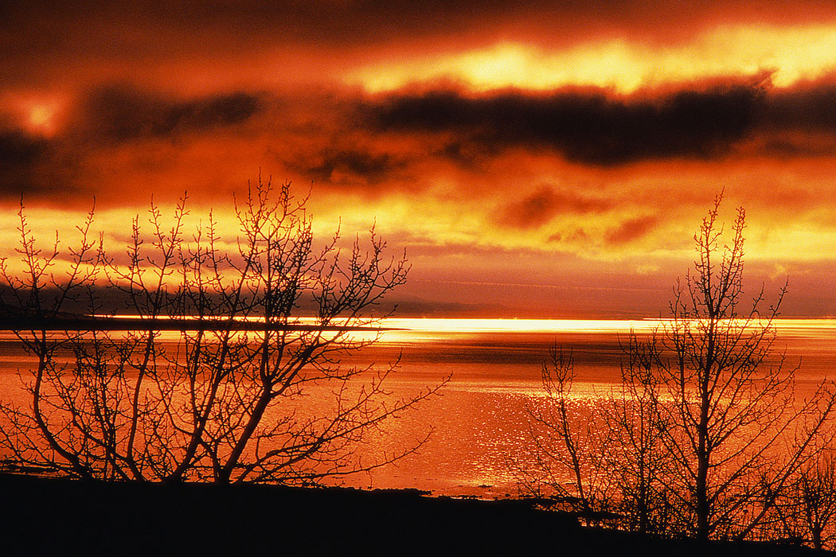
Summertime Sins
“Then He spoke to them a parable: ‘Look at the fig tree, and all the trees. When they are already budding, you see and know for yourselves that summer is now near’”
(Lk. 21:29, 30)
Notes:
God placed the varying seasons that come upon the earth long ago. With each of them there is an attraction and beauty of some sort. With summer, there seems to be a stronger desire to be outside in general. Many take vacations during this time of year, schools are out, there are all kinds of outdoors activities that are going on.
But there are also signs of decadence in summertime too. When Jesus was speaking about things to look for regarding the destruction of Jerusalem, he spoke about how trees show signs of summer approaching.
Well, I can see signs of summer's allurements and the weakness of brethren too.

Slide 2
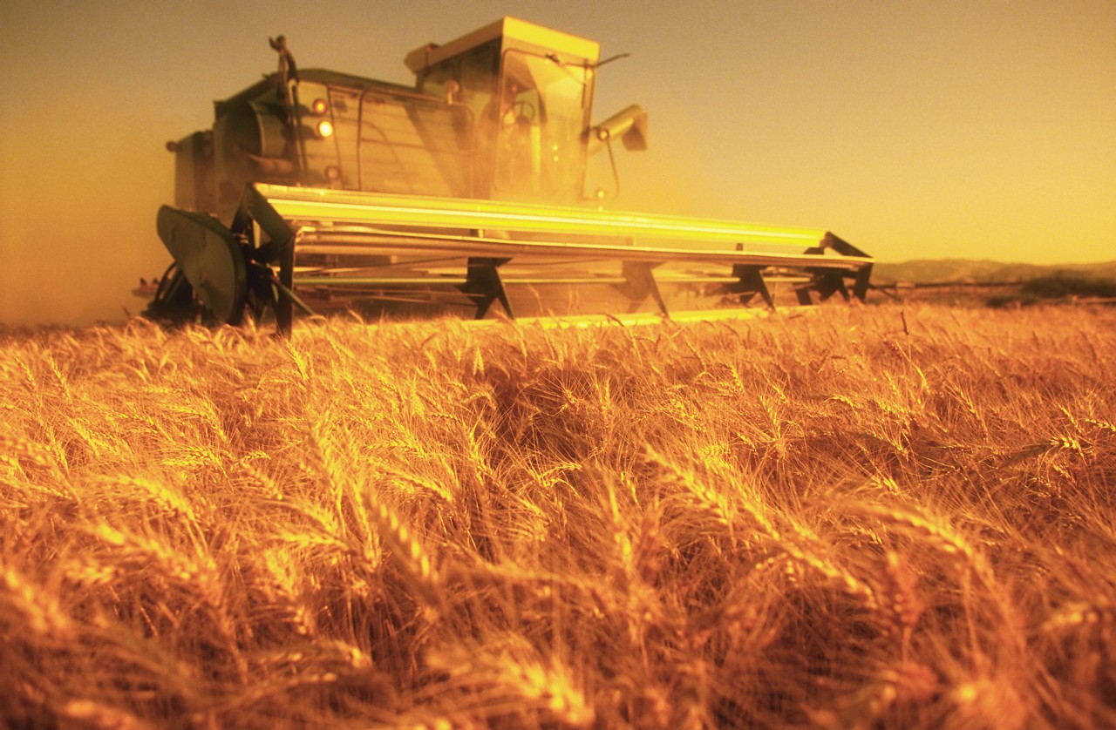
Jeremiah 8:19, 20
19 Listen! The voice, The cry of the daughter of my people from a far country: "Is not the LORD in Zion? Is not her King in her?" "Why have they provoked Me to anger With their carved images––with foreign idols?"
20 "The harvest is past, The summer is ended, and we are not saved!"
Notes:
When Jeremiah’s people were given over to idolatry, God sent them away into Babylonian captivity. Will such sad words be spoken of us? ‘The harvest is past, the summer is ended and we are not saved”?

Slide 3
Summertime Sins
IMMODESTY
Notes:
Immodesty can take place anytime of year, but it seems especially in place during the warmer months. Does God say anything about the way we dress? Does God have a law regarding it? Does God even care? Does anything go for dress?

Slide 4

What Is The Fundamental Reason For Wearing Clothing?
Notes:
The whole subject of modest hinges really on the fundamental reason why people wear clothes.

Slide 5
Because of Sin
Adam & Eve
  “Then the eyes of both of them were opened, and they knew that they were naked; and they sewed fig leaves together and made themselves coverings” (Gen. 3:7)
    “loin coverings” (NASB)
    “aprons” (KJV)
    “belt” (cf. 2 Sam. 18:11; 1 Kin. 2:5, NKJV)
Notes:
When Adam and Eve ate of the forbidden tree, they were aware of their nakedness and sought to cover it. It so happened that fig trees grew in the Garden of Eden and they did something quickly that they had never done before. They had sewed fig leaves together to make a covering for their bodies.
Observation: at least when they discovered their nakedness, they sought to cover it. The mindset among many today is when they find their nakedness covered that they seek to uncover it. Adam & Eve didn’t want to be naked. We have people today who want to be naked. Folks, we live on this side of the eaten tree of knowledge, not the other. We should dress like it! Genesis tells us in bold language the purpose of clothing and that is to cover not reveal. But even their coverings were not sufficient.
[CLICK] They were lion coverings, a covering which merely covered the waist. Man, by his own plan, his own works, his own thinking, his own energies is always lacking of God’s standards.

Slide 6
Appropriate Coverings
Adam & Eve
  ⁸ And they heard the sound of the LORD God walking in the garden in the cool of the day, and Adam and his wife hid themselves from the presence of the LORD God among the trees of the garden. ⁹ Then the LORD God called to Adam and said to him, "Where are you?" ¹⁰ So he said, "I heard Your voice in the garden, and I was afraid because I was naked; and I hid myself" (Gen. 3:8-10; cf. Jn. 21:7)
Notes:
This is after Adam clothed himself. [CLICK] He heard God’s word, was afraid BECAUSE he was naked. He hid BECAUSE he was naked! Yet, Adam clothed himself, so why be afraid??? He was still naked, even with his covering. For the first time he experienced the feeling of shame! It was a feeling that he had never known before. He just knew that he didn’t want to stand before the all Holy God in the state in which he was.
It reminds me of Peter’s example in the New Testament, “Therefore that disciple whom Jesus loved saith unto Peter, It is the Lord. Now when Simon Peter heard that it was the Lord, he girt his fisher’s coat unto him, (for he was naked,) and did cast himself into the sea” (Jn. 21:7, KJV). He was only wearing the inner garment which made it easier to work in, but when he saw the Lord, he covered himself up with the outer garment.
McGarvey comments, “The arduous task of fishing had caused Peter to lay aside his upper garment; but as he prepares to meet the Lord he puts it on, moved by reverence and respect for the Master, though it encumbered him greatly in his efforts to swim” (TFG 755-56). Peter recognized the need of wearing something more when meeting Jesus. Adam did too!
Yet, today, men arrogantly take their stand with no shame before God in their shameful attire! Rather than feeling shame, they feel nothing in their naked or improperly clothed stance.

Slide 7
Appropriate Coverings
Adam & Eve
  “Also for Adam and his wife the LORD God made tunics of skin, and clothed them” (Gen. 3:21)
    Adam’s clothing was insufficient
    they were “covered” with their leaves but were still unclothed!
Notes:
This passage shows that Adam’s work was insufficient. His clothing was not correct. God further clothed him with tunics or “robes” of skin.
Not only is this a passage which teaches us a great deal of knowledge on dress, but it also shows us the gospel picture in a very beautiful stroke. The nakedness of the flesh parallels somewhat the nakedness of the soul in sin. It desperately needs clothed but our own works and inventions all fail to cover us.
We need the blood-sacrifice and atonement of the Lamb of God to give us tunics for the soul. It may be in this vein that John wrote, “. . .These are the ones who come out of the great tribulation, and washed their robes and made them white in the blood of the Lamb” (Rev. 7:14).

Slide 8
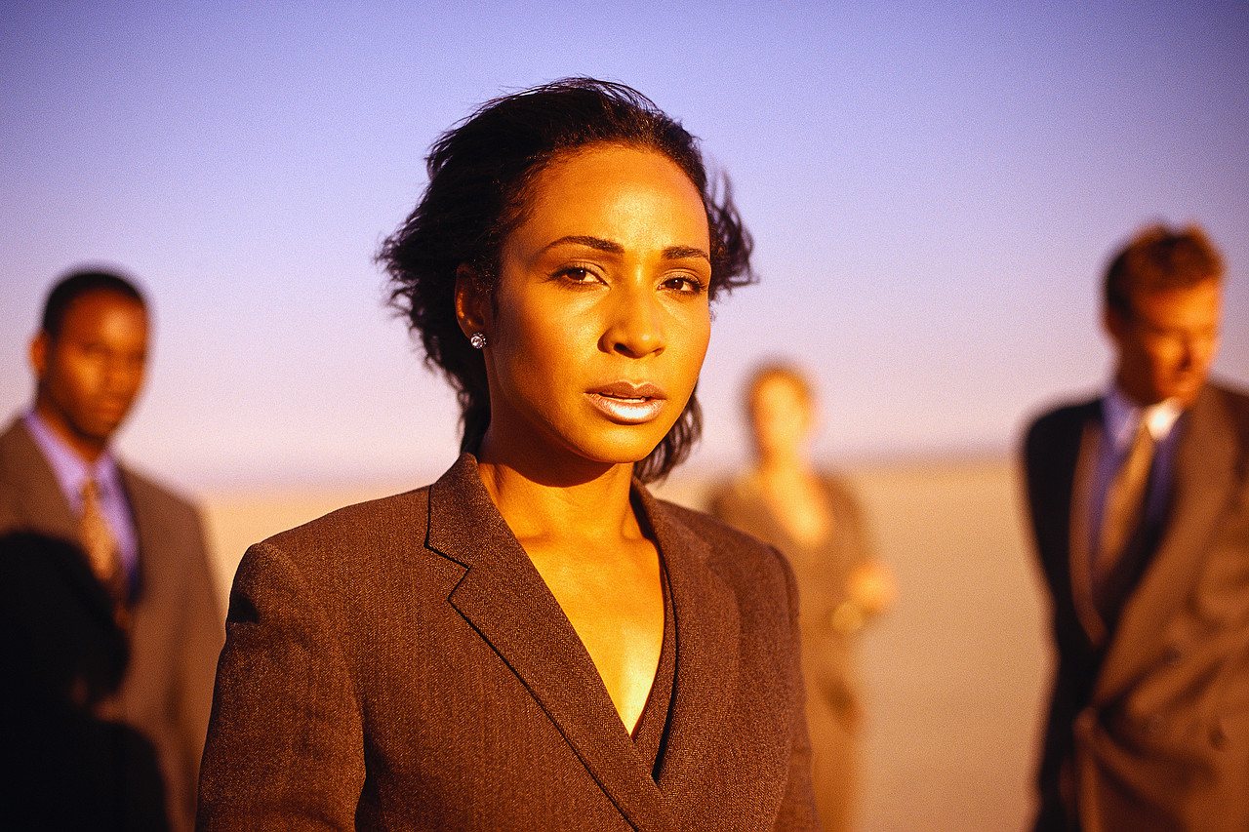
1 Timothy 2:9, 10
9 in like manner also, that the women adorn themselves in modest apparel, with propriety and moderation, not with braided hair or gold or pearls or costly clothing,
10 but, which is proper for women professing godliness, with good works.
  “modest” –well arranged, seemly
  “propriety” –regard for others, bashfulness, reverence (“shamefacedness” KJV)
  “moderation” –soundness of mind, soberness, self-control
Notes:
The Bible stresses that woman clothes herself in a godly way. Braided hair, expensive jewelry, and expensive clothing is not what makes one modest any more than the removal of the filth from the flesh makes one baptized. Modesty doesn’t have to be an expensive art and yet, it is very costly for women to not be modest.
[CLICK THRU]
modest – seemly “appropriate, fitting, etc.”
propriety – women should dress with eyes cast down or a bashfulness toward men.
moderation - soundness, soberness, self-control

Slide 9

Are You A Woman?
“And this I say for your own profit, not that I may put a leash on you, but for what is proper, and that you may serve the Lord without distraction”
(1 Cor. 7:35)
Is your attire in public:
  Modest
  Reverent
  Designed to regard the conscience of others
  Sound
  Sober
  Conveying self-control
Notes:
Christianity is concerned with what the mind of others think in many areas. Even in the subject of eating meats, Paul spoke regarding the weaker brethren, in 1Co 10:29 “ ‘Conscience,’ I say, not your own, but that of the other. For why is my liberty judged by another man’s conscience?” Do you dress with concern for others?

Slide 10

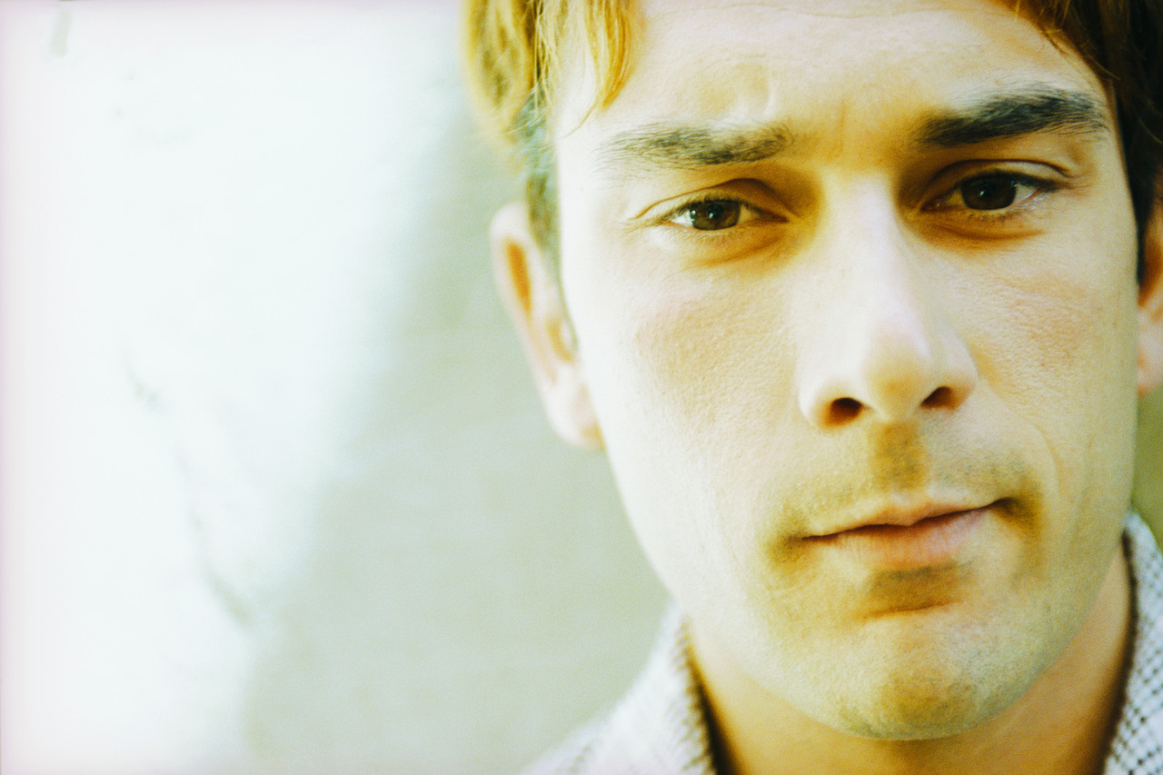
Men Are NOT Excluded
Titus 2:6-8
  ⁶ Likewise exhort the young men to be sober–minded,
  ⁷ in all things showing yourself to be a pattern of good works; in doctrine showing integrity, reverence, incorruptibility,
  ⁸ sound speech that cannot be condemned, that one who is an opponent may be ashamed, having nothing evil to say of you.
INCLUDES CLOTHING
Notes:
[CLICK]

Slide 11
Wearing Immodest Apparel
is not sober-minded
is not concerned for the thoughts of others
displays a spirit that is conformed to the world (Rom. 12:2)
is sin
Notes:
"And do not be conformed to this world, but be transformed by the renewing of your mind, that you may prove what is that good and acceptable and perfect will of God" (Rom. 12:2)

Slide 12
How Are These Modest???
swim suits
bikinis
short shorts
mini skirts
half shirts
tight body molding clothing
low cut shirts
“And there a woman met him, with the attire of a harlot, and a crafty heart” (Prov. 7:10)
Notes:
Do these things really bring honor to Christ? Do they exalt the church? Do they promote good thoughts? Do they help others want to be a Christian? Do they teach the definition of modesty or harlotry?
Prov. 7:10, the reason this woman wore the attire of a harlot is because of he crafty heart. That is wear the battle of modesty is won or lost. . .in the heart!
Would you feel confident wearing any of these if Jesus returned and saw you in them?
END of SERMON 1

Slide 13
Summertime Sins
FORSAKING
The Assembling of
SAINTS
Notes:
BEGIN SERMON 2
Sometimes in the summer (but not exclusively the summer) people tire themselves out with their worldly pursuits and now all of a sudden, the church doesn’t shine so bright in their lives.
The services of the church (which has an effect for eternity) is now found in a competition with the activities on earth (which only last a season). (Consider the confession of Bruce Riney.)
Sporting events, vacations, and even the “JOB” are good things, but should not be in competition with the kingdom of heaven. Summer can be a testing ground for your faith.
This is probably a sin that everyone has struggled with from one time or another in their life. But it is serious, nonetheless.

Slide 14
“not forsaking the assembling of ourselves together, as is the manner of some, but exhorting one another, and so much the more as you see the Day approaching” Heb. 10:25
FORSAKING – abandon, desert, to leave surviving
ASSEMBLING – gathering together (of ourselves)
  all religious gatherings of Christians in the congregation where we are members
THE MANNER OF SOME
  “habit” (New American Standard Greek Lexicon)
Notes:
[CLICK] Forsaking is to abandon . . .to forsake or abandon something necessarily implies that you have a duty/obligation to it.
You don’t forsake anything where you have no obligation.
[CLICK] ASSEMBLING: is the gathering of Christians together for religious purposes. You are not forsaking the assembling if you do not go to a potluck. But you are forsaking the assembling if you choose to neglect the services of the church.
[CLICK] Forsaking can develop into a habit. Regular worship can develop into a habit too. I speak of this in a positive way. You get to the point where you don't have to decide if you are going to services on Sunday and midweek. You don't have to consult your planer. You already know where you will be.

Slide 15
Can Make You Lost!
forsaking
To neglect the assembling of saints is to SIN!
God always held those who forsook the religious assemblies with contempt
  “But the man who is clean and is not on a journey, and ceases to keep the Passover, that same person shall be cut off from among his people, because he did not bring the offering of the LORD at its appointed time; that man shall bear his sin” (Num. 9:13)
legitimate reasons
not defiled by a dead man
shall die, be lost and condemned
not hung up too far away from Jerusalem
Notes:
CLICK THRU

Slide 16
Ways People Forsake
attending the “Mattress Springs Church of Christ”
  too tired to get up
seeks first work and employer rather than the kingdom
  “gladly” takes extra hours at the job when it conflicts with worship
  “gladly” takes a job that will take him/her away from the worship services
    Never tells employer that the commitment to worship God comes before the job

Slide 17
Ways People Forsake
recreate away from God
  pretends he is a church by taking the elements of the Lord’s Supper with him on his pleasure trip
  doesn’t bother searching for a sound church to worship with when gone
  vacations from his duty to give
gives little concern about “Bible study”
  only concerned with getting to
  “worship”
  do as little as possible/seek minimum
  service
Sunday Sickness
Notes:
CLICK
[CLICK] NOTE1: L.S. is to be done when brethren come together as a church (1 Cor. 11:18; 20). Not alone, out and away from the church service.
[CLICK] NOTE2: we have provided those of you with computers links on our websites with sound churches. We even provide links where you cans search for the church in various areas. Use it!
[CLICK thru]

Slide 18
Why People Forsake
Forsaking is sin, but other sins lead to the action
  Not seeking first the kingdom of God (Matt. 6:33)
  Loving something more than God (Mk. 12:30)
    We create idols when we place anything before God

Slide 19
Deuteronomy 5:8-10
8 ‘You shall not make for yourself a carved image—any likeness of anything that is in heaven above, or that is in the earth beneath, or that is in the water under the earth;
9 you shall not bow down to them nor serve them. For I, the LORD your God, am a jealous God, visiting the iniquity of the fathers upon the children to the third and fourth generations of those who hate Me,
10 but showing mercy to thousands, to those who love Me and keep My commandments.
Notes:
Keeping the commandments of God displays love to Him. But creating idols and serving them is a display of our hate toward God. It is very cut and dry with Him. We either love Him or hate Him. Our actions display the emotion we have.

Slide 20
Consider Hebrews 10:22-39
BRETHREN WHO FORSAKE. . .
do not draw near to God (v. 22)
do no have hearts full of faith (v. 22)
do not hold fast confession of faith (v. 23)
do not have consideration for brethren (v. 24)
  do not exhort brethren

Slide 21
Consider Hebrews 10:22-39
BRETHREN WHO FORSAKE. . .
do not consider the “day” that is approaching (v. 25, cf. 27, 29, 30, 37)
  The fact of a future judgment day should behoove us all to be at every service!
sin willfully (v. 26)
forfeit the sacrifice for sins (v. 26)
await a judgment that is worse than that under Moses (v. 27-29)
trample under feet holy blood (v. 29)
Notes:
[CLICK THRU]

Slide 22
Consider Hebrews 10:22-39
BRETHREN WHO FORSAKE. . .
are neglectful of the covenant (v. 29)
insult the Spirit (v. 29)
have forgotten their former state (vv. 32, 33)
are not compassionate for brethren (v. 34)
have forgotten about heaven (v. 34)
cast away their confidence (v. 35)
have no endurance (v. 36)
give little thought of the second coming (v. 37)
are not living by faith but drawing back (v. 38)
do not have to continue to do so (v. 39)
Notes:
When you forsake the assemblings of saints, you not only trample the holy blood that ratified the covenant, but you also insult the Spirit who revealed the covenant! That means you stand before God in judgment without Jesus and the Holy Spirit. I don't envy that place!!!

Slide 23
Forsaking the Assembling of Ourselves
Toge
ther
Forsakes His Appointment To Commune With The Lord
  1 Cor. 11:23-34
Shows That He Prefers Someone Or Something Above The Lord
  Matt. 18:20; Lk. 14:15-24; 9:57-62; 14:26
The Person That Willfully Forsakes…
Notes:
charts 20-22 by Steve Monts
[CLICK]
[CLICK] The Lord’s presence is certainly in the church’s assembly. Choosing to willfully not come is choosing something above the Lord (read Lk. 14:15-24).

Slide 24
Forsaking the Assembling of Ourselves
Toge
ther
Denies His Allegiance To Christ That He Confessed At His Baptism
  Rom. 10:9-10; 2 Tim. 2:4; Heb. 12:2
Is Not Seeking First The Kingdom Of God And His Righteousness
  Matt. 6:33
The Person That Willfully Forsakes…
Notes:
CLICK THRU

Slide 25
Forsaking the Assembling of Ourselves
Toge
ther
The Person That Willfully Forsakes…
Offends The Church Of God
  1 Cor. 10:32
Hinders The Efforts Of The Church To Preach The Gospel
  1 Cor. 9:12
Neglects The Worship God Is Seeking
  Jn. 4:23-24
Notes:
[CLICK] “Give no offense, either to the Jews or to the Greeks or to the church of God” (1 Cor. 10:32)
[CLICK] “If others are partakers of this right over you, are we not even more? Nevertheless we have not used this right, but endure all things lest we hinder the gospel of Christ” (1 Cor. 9:12). The gospel can be hindered. Now, are you helping or hindering it when you are not here? What does it tell your neighbors, friends, children?
[CLICK]

Slide 26
What You Miss When You Are Willfully Gone!
singing
praying
learning
honoring God
approval from God
“Examine yourselves as to whether you are in the faith. Test yourselves. Do you not know yourselves, that Jesus Christ is in you? ––unless indeed you are disqualified”
(2 Cor. 13:5)
Notes:
Presenting lessons like this is for the benefit of the hearers. Worship is serious and we need to be serious about it. How we react to lessons like this shows what effect the word of God is having upon us. We need to examine ourselves. I am never beyond examination and neither should you be.

Slide 27
The PAST Doesn’t Have to Equal the FUTURE!
Even Saul said, "Indeed I have played the fool and erred exceedingly" (1 Sam. 26:21)
Notes:
I am not presenting this lesson to beat up on any one person. I simply want us to challenge ourselves to maturity. I want us to be honest and serious about who we are and to refuse the temptation to “play the fool.”
Even Saul said, "Indeed I have played the fool and erred exceedingly" (1 Sam. 26:21)
I want us to be more tomorrow than we are today. Our every action and in action has an effect on that growth! Think about it!
I want us to give grave consideration to the course we are chartering. Is it healthy for us? Is it good for our children? If you don’t have children but plan on having them, don’t you think it is important to get your ducks in a row now?
Why play the fool and wake up one day and see your children lost because they learned from your example to not esteem the services of the church???
They will learn from you and they will take your failure to newer depths.

